Slide 1
10/30/2024 Molecular Simulation
Today’s lecture and exercise are intended to help you achieve the following learning objectives: recall the purpose of key algorithms in molecular dynamics
Revision of Exercise 6
Molecular simulation methods
Metropolis Monte Carlo
Molecular Dynamics
Compare/contrast and combine
Exercise 8: Performing a Molecular Simulation with OpenMM

Slide 2

Metropolis Monte Carlo
A specific smarter way to sample the Nile
Metropolis, N.; Rosenbluth, A. W.; Rosenbluth, M. N.; Teller, A.; Teller, E. Equation of State Calculations by Fast Computing Machines. Journal of Chemical Physics 1953, 21 (6), 1087–1092.

Slide 3
About Metropolis Monte Carlo
First Markov chain Monte Carlo algorithm
Used throughout scientific computing
“Metropolis et al. introduced the sampling method and periodic boundary conditions that remain at the heart of Monte Carlo statistical mechanics simulations of fluids. This was one of the major contributions to theoretical chemistry of the twentieth century.” - William Jorgensen, 2011
“Hastings generalized the Metropolis algorithm into the well-known Metropolis–Hastings algorithm (MH)” … “the celebrated Metropolis–Hastings algorithm has the highest acceptance probability of all Hastings algorithms” - Minh & Minh, 2015

Slide 4
Metropolis Monte Carlo
Nicholas Metropolis -
provided computing time,
gets most credit!
Arianna Rosenbluth -
final implementation
of code
Marshall Rosenbluth -
“[We] did all the work”
Edward Teller,
“Father of H bomb” -
key suggestion
Augusta Teller -
wrote draft
of code
Gubernatis, J. E. Marshall Rosenbluth and the Metropolis Algorithm. Physics of Plasmas 2005, 12 (5), 057303. https://doi.org/10.1063/1.1887186

Slide 5
The Metropolis Algorithm
Draw A from initial π
Generate B with probability $Q\left(A→B\right)$
Generate $u\sim U(0,1)$
$$α(A→B)=min\left(1,\frac{π\left(B\right)Q\left(B→A\right)}{π\left(A\right)Q\left(A→B\right)}\right)$$
NO
0
1
Reject (A → A)
$u≤α(A→B)$
YES
Accept (A → B)

Slide 6
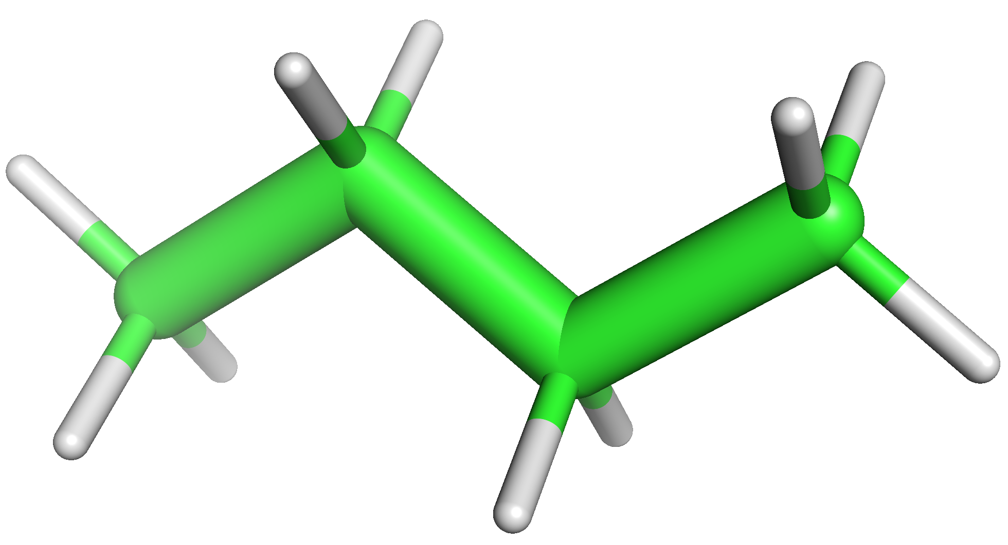
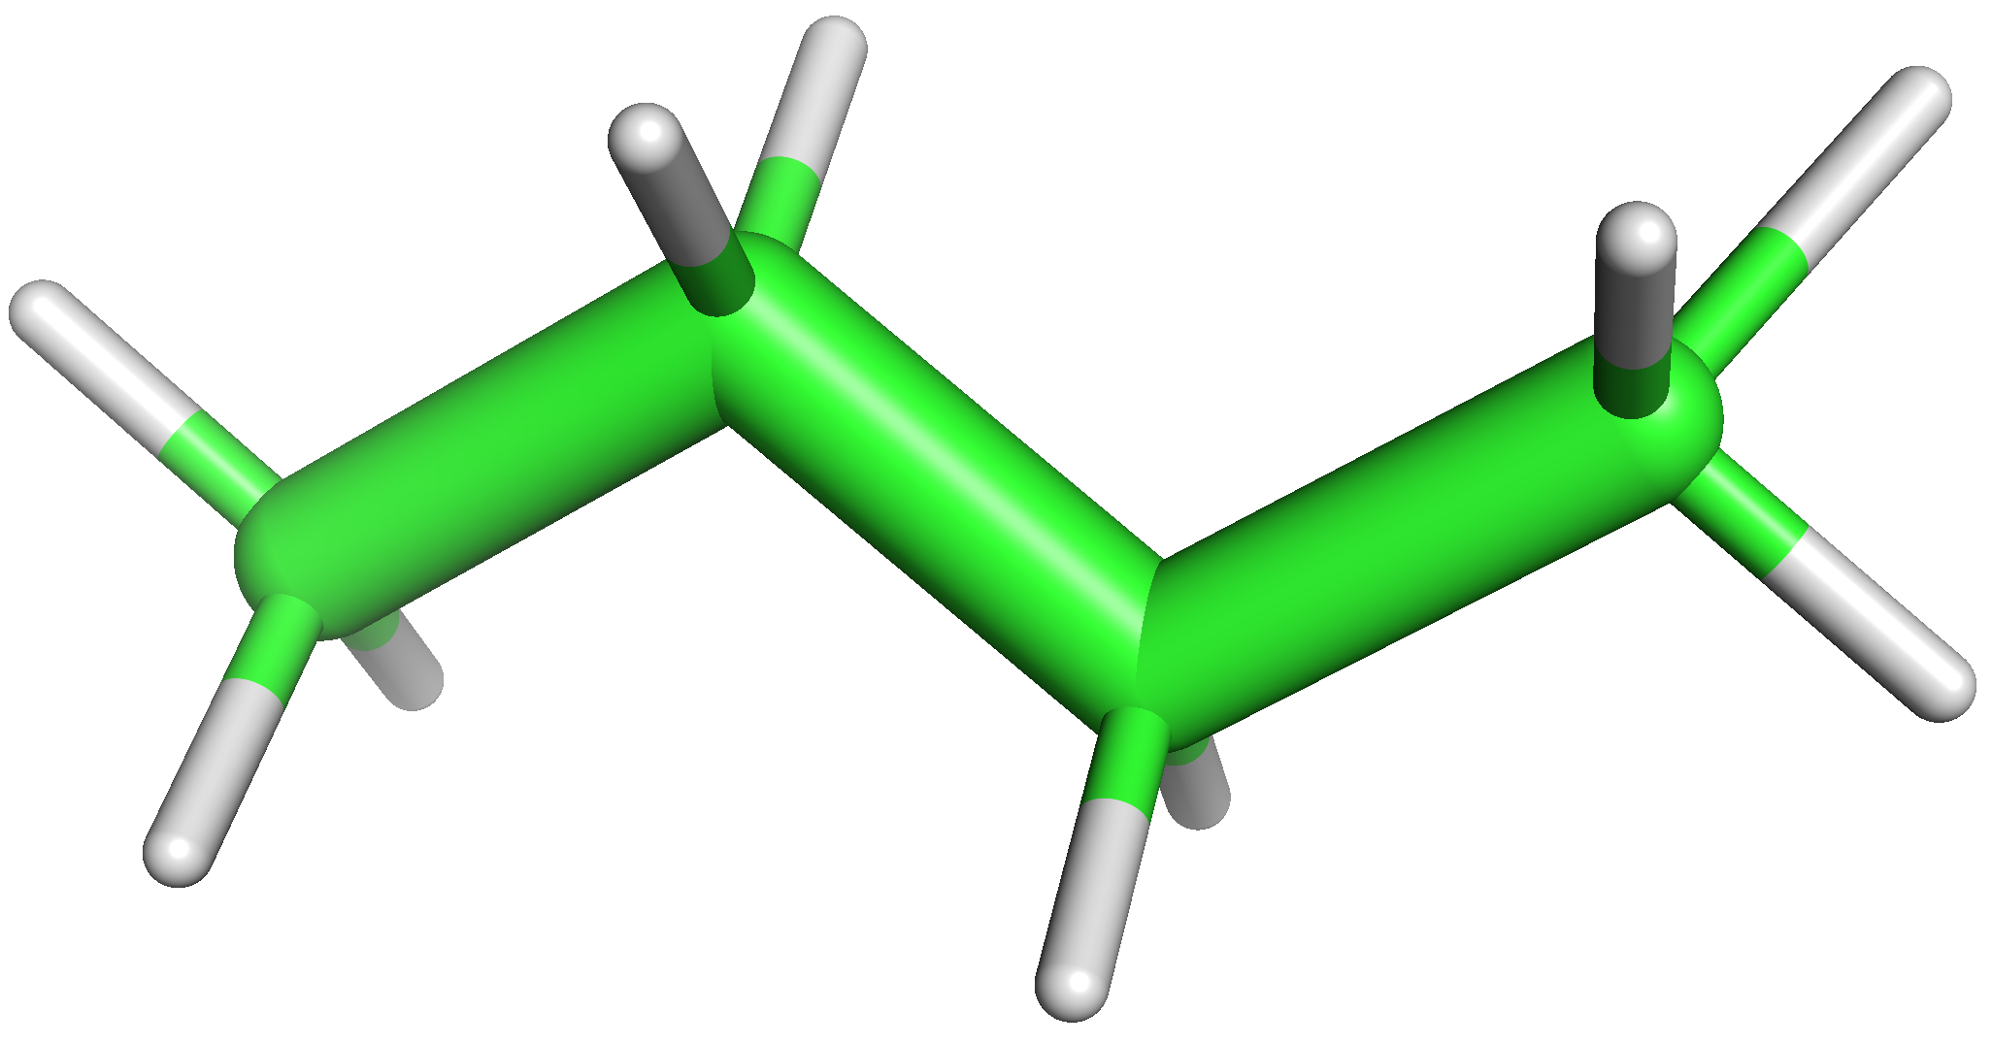
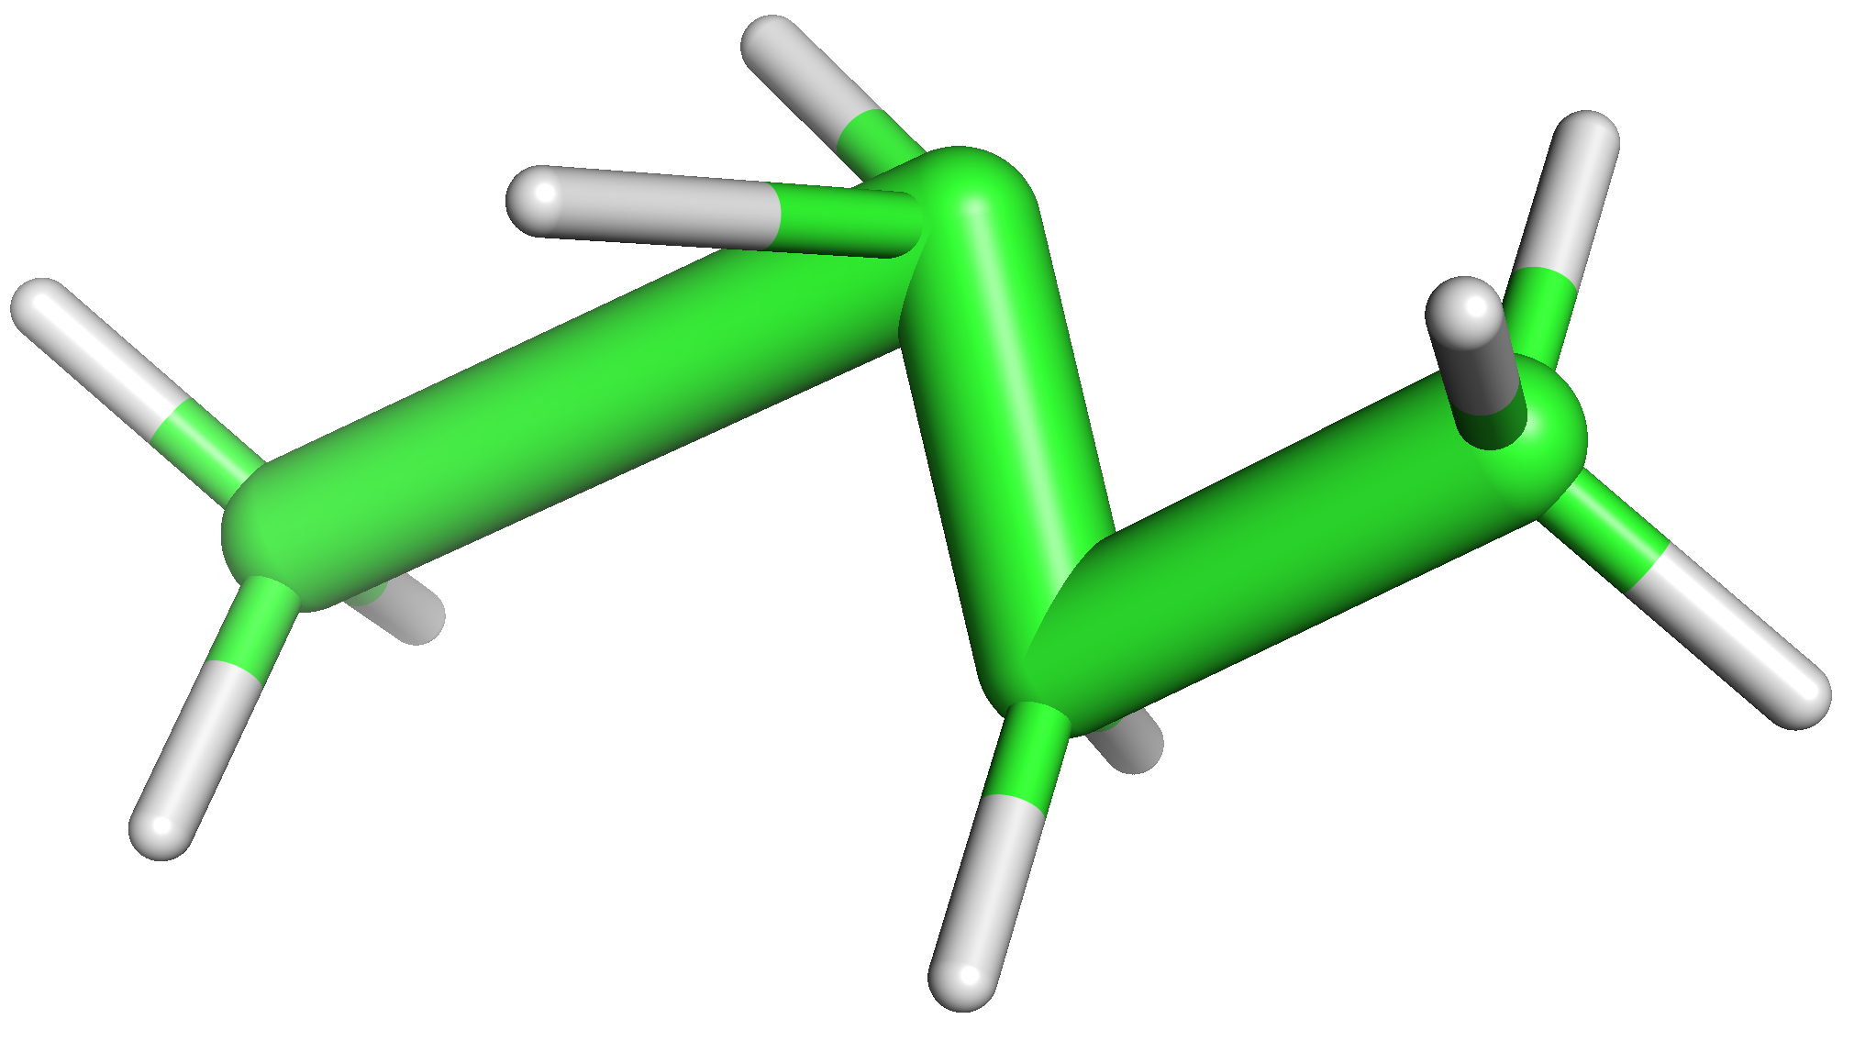
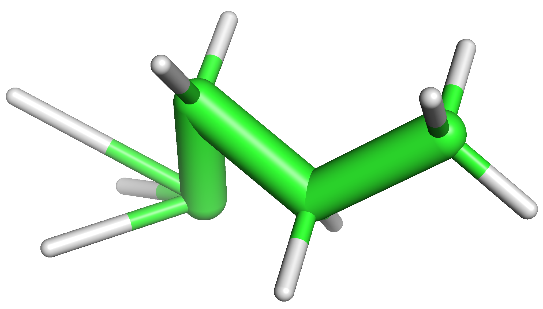
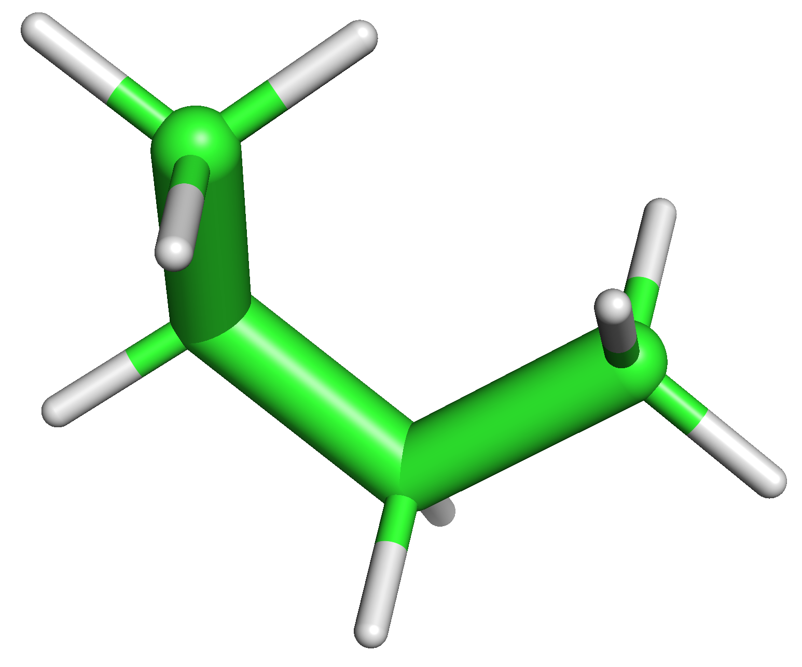
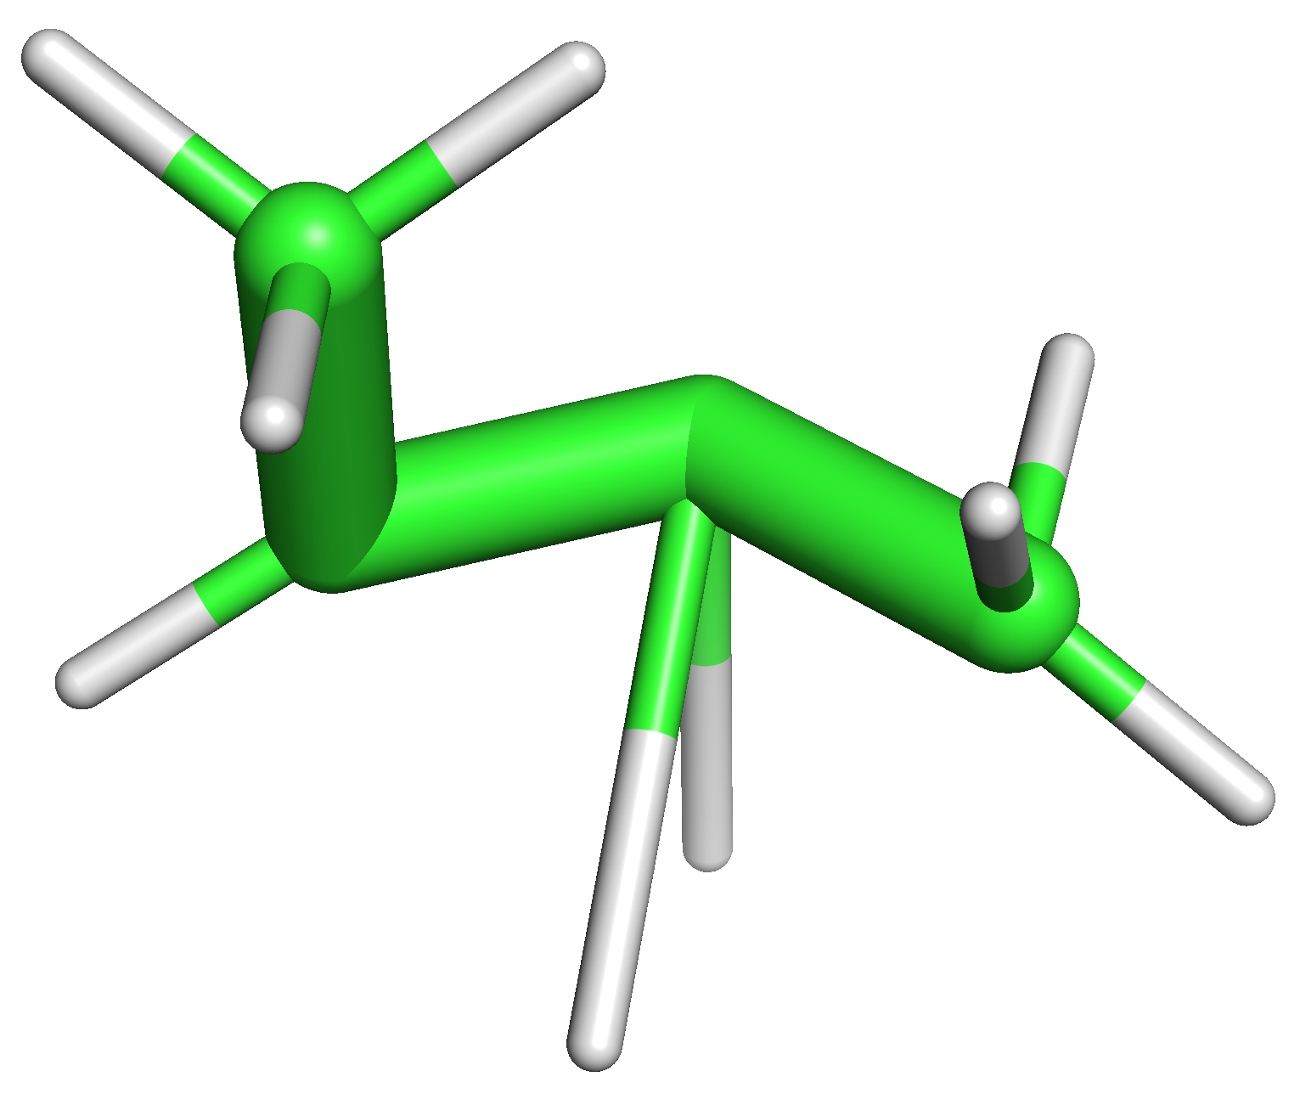
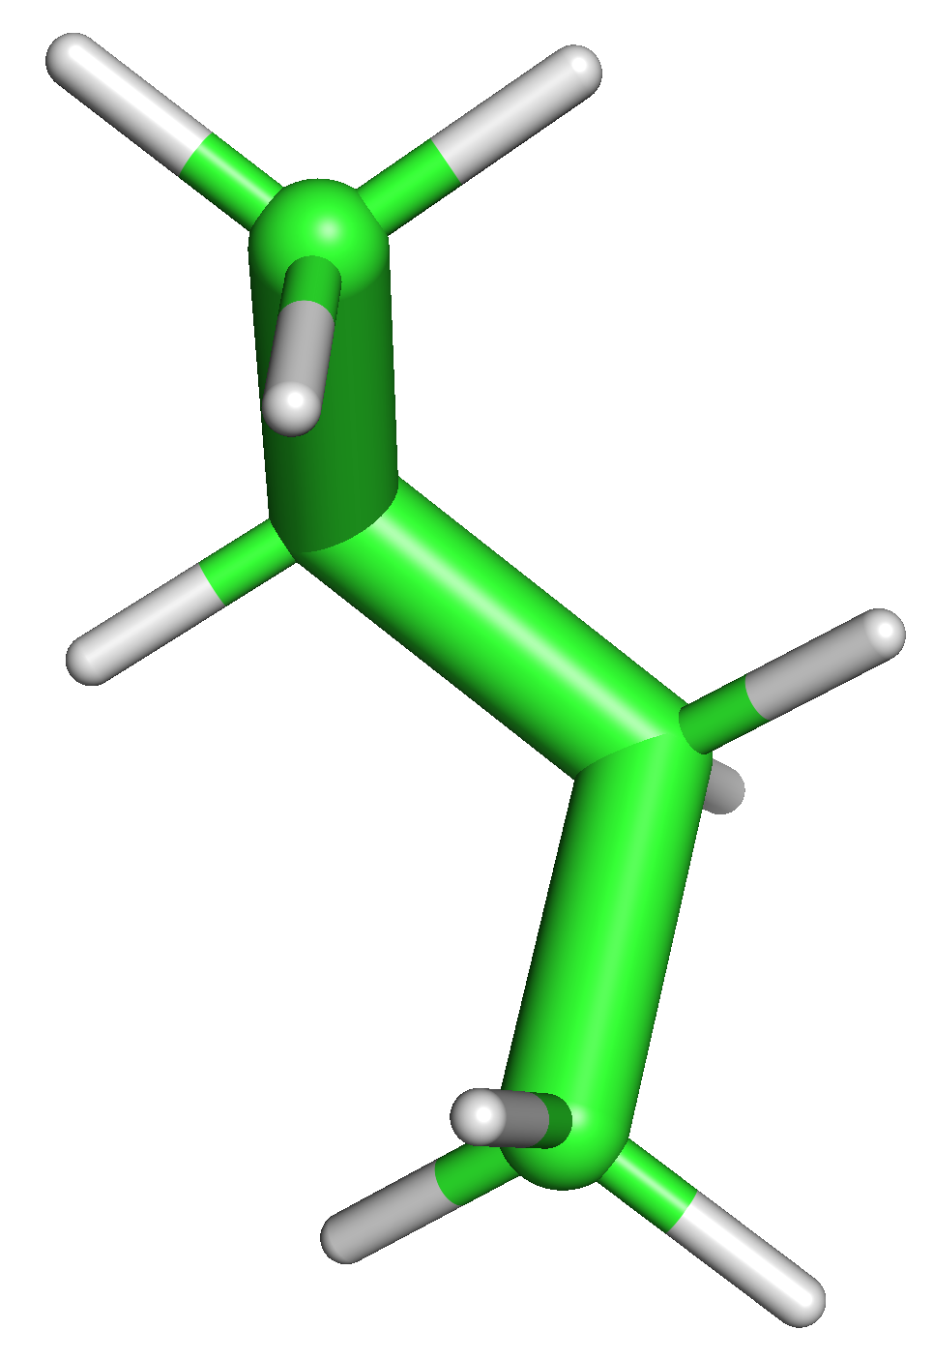
Schematic Markov chain for Molecules
Attempts
Stochastic Process
$$X_{1}$$
$$X_{2}$$
$$X_{3}$$
$$X_{4}$$
$$X_{5}$$
$$X_{6}$$
$$X_{7}$$

Slide 7
The Metropolis–Hastings Acceptance Criterion
Enforces detailed balance, causing stationary distribution to match target distribution
With equal transition probabilities,
moves to higher probability (lower energy) are always accepted
moves to lower probability (higher energy) are sometimes accepted, depending on this ratio
detailed balance
$$π\left(A\right)P\left(A→B\right)=π\left(B\right)P\left(B→A\right)$$
proposal distribution
$$π\left(A\right)Q\left(A→B\right)≠π\left(B\right)Q\left(B→A\right)$$
correcting term
$$π\left(A\right)Q\left(A→B\right)α(A→B)=π\left(B\right)Q\left(B→A\right)α(B→A)⇔\frac{α(A→B)}{α(B→A)}=\frac{π\left(B\right)Q\left(B→A\right)}{π\left(A\right)Q\left(A→B\right)}$$
Metropolis-Hastings
$$α\left(A→B\right)=min\left(1,\frac{π\left(B\right)Q\left(B→A\right)}{π\left(A\right)Q\left(A→B\right)}\right)$$
Notes:
Alternative demonstration: https://www.youtube.com/watch?v=5lyw0nnyJt8 .

Slide 8
Molecular Dynamics

Slide 9
What is Molecular Dynamics?
Add energy to a system modeled by molecular mechanics and simulate its progress with time using Newton’s second law of motion $\overset{→}{F}=ma$
See 0:45 to 2:20 of “An Introduction to Molecular Dynamics” (https://www.youtube.com/watch?v=lLFEqKl3sm4)
See a separation of alkane and water: https://www.youtube.com/watch?v=xcMSHy3CqXA

Slide 10
Why do biological molecular dynamics?
“everything that living things do can be understood in terms of the jigglings and wigglings of atoms” - Richard Feynman
Check out David’s molecular dynamics YouTube playlist: https://www.youtube.com/playlist?list=PLYEyeVFrqfAu0ft6sF4vVe5FOEbJYyi_L

Slide 11
General MD Algorithm
Figure 2 of Durrant & McCammon, 2011

Slide 12
Some more MD details
Integrator
Algorithm for moving atoms according to forces
Can be deterministic (e.g. velocity Verlet) or stochastic (e.g. Langevin)
Choice can affect numerical stability and time step
Constraints
Degrees of freedom fixed to specific values
Lengths of bonds involving H
Rigid water
Torsional dynamics
Can allow for a larger time step [Spiridon & Minh, 2017]

Slide 13
Fixing thermodynamic variables
Thermostat
Maintains temperature
Part of integrator, e.g. Langevin dynamics, or separate Monte Carlo move
Andersen thermostat - periodically reinitialized velocity according to the Maxwell-Boltzmann distribution
Barostat
Maintains pressure
Monte Carlo move that changes system volume

Slide 14
Molecular Dynamics and Markov Chain Monte Carlo
Compare/contrast and combine

Slide 15
Compare/Contrast
 | MCMC | MD
Uses random numbers as its main tool | X
Particles have velocity |  | X
Includes the Metropolis algorithm | X
Allows the calculation of averages | X | X
In principle, has memory of its past |  | X

Slide 16
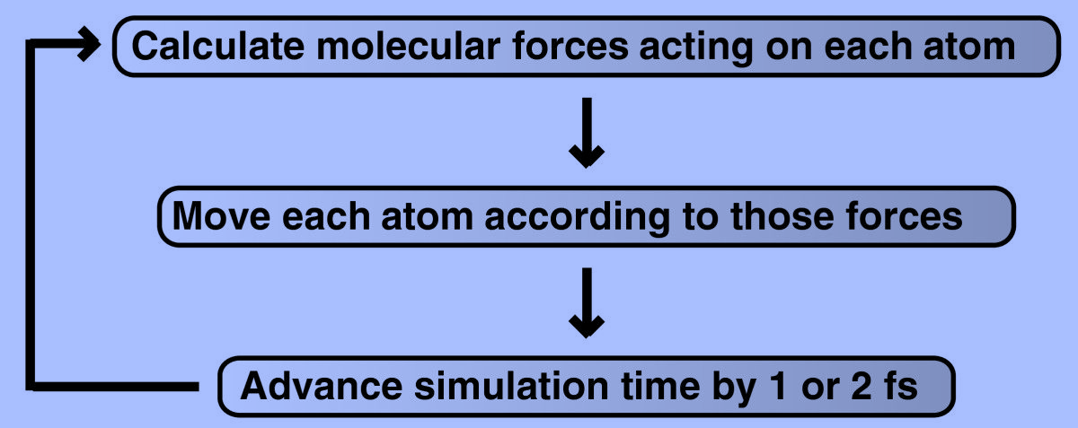
Hybrid Monte Carlo
Draw A from initial π
Generate B with probability $Q\left(A→B\right)$
$$α(A→B)=min\left(1,\frac{π\left(B\right)Q\left(B→A\right)}{π\left(A\right)Q\left(A→B\right)}\right)$$
Molecular Dynamics
Metropolis-Hastings
Algorithm
Generate $u\sim U(0,1)$
NO
$u≤α(A→B)$
YES
Reject (A → A)
Accept (B → A)
Duane, S.; Kennedy, A. D.; Pendleton, B. J.; Roweth, D. Hybrid Monte Carlo. Physics Letters B 1987, 195 (2), 216–222.
21

Slide 17
Some specific types of HMC
Nonequilibrium candidate Monte Carlo - use driven process, changing potential energy with time, to generate candidate configuration
Constrained dynamics, e.g. torsional dynamics
Nilmeier, J. P.; Crooks, G. E.; Minh, D. D. L.; Chodera, J. D. PNAS Plus: Nonequilibrium Candidate Monte Carlo Is an Efficient Tool for Equilibrium Simulation. Proceedings of the National Academy of Sciences of the United States of America 2011, 108 (45), E1009–E1018. https://doi.org/10.1073/pnas.1106094108.
Spiridon, L.; Minh, D. D. L. Hamiltonian Monte Carlo with Constrained Molecular Dynamics as Gibbs Sampling. Journal of Chemical Theory and Computation 2017, 13 (10), 4649–4659. https://doi.org/10.1021/acs.jctc.7b00570.
21

Slide 18
References
Durrant, J. D.; McCammon, J. A. Molecular Dynamics Simulations and Drug Discovery. BMC Biol 2011, 9 (1), 71. https://doi.org/10.1186/1741-7007-9-71, adapted under the CC BY 2.0 license.
Grossfield A, Zuckerman DM. Quantifying uncertainty and sampling quality in biomolecular simulations. Annu Rep Comput Chem. 2009 Jan 1;5:23-48. doi: 10.1016/S1574-1400(09)00502-7. PMID: 20454547; PMCID: PMC2865156.
Gubernatis, J. E. Marshall Rosenbluth and the Metropolis Algorithm. Physics of Plasmas 2005, 12 (5), 057303. https://doi.org/10.1063/1.1887186.
Metropolis, N.; Rosenbluth, A. W.; Rosenbluth, M. N.; Teller, A.; Teller, E. Equation of State Calculations by Fast Computing Machines. Journal of Chemical Physics 1953, 21 (6), 1087–1092.
Minh, D. D. L.; Minh, D. L. (Paul). Understanding the Hastings Algorithm. Communications in Statistics - Simulation and Computation 2015, 44 (2), 332–349. https://doi.org/10.1080/03610918.2013.777455.
Nilmeier, J. P.; Crooks, G. E.; Minh, D. D. L.; Chodera, J. D. PNAS Plus: Nonequilibrium Candidate Monte Carlo Is an Efficient Tool for Equilibrium Simulation. Proceedings of the National Academy of Sciences of the United States of America 2011, 108 (45), E1009–E1018. https://doi.org/10.1073/pnas.1106094108.
Spiridon, L.; Minh, D. D. L. Hamiltonian Monte Carlo with Constrained Molecular Dynamics as Gibbs Sampling. Journal of Chemical Theory and Computation 2017, 13 (10), 4649–4659. https://doi.org/10.1021/acs.jctc.7b00570.
Duane, S.; Kennedy, A. D.; Pendleton, B. J.; Roweth, D. Hybrid Monte Carlo. Physics Letters B 1987, 195 (2), 216–222.

Slide 19
Exercise 8: Performing a Molecular Simulation with OpenMM
https://colab.research.google.com/github/daveminh/Chem456-2024F/blob/main/exercises/08-OpenMM.ipynb

